Slide 1
Chapter 5 : Input-Output subsystem of computer system
In addition to the processor and a set of memory modules, the third key element of a computer system is input-output subsystem called I/O.
This subsystem is responsible for managing the communication between the central processing unit (CPU) and external devices.
Those external devices are storage devices, displays, keyboards, mice, printers, and network interfaces.
A transfer is either output from the CPU and input to the peripheral or output from the peripheral and input to the CPU through this input output subsystem.
Therefore, Input/output (I/O), in computing, is a communication process between a computer and the outside world.

Slide 2
Peripheral devices
Peripheral devices, in the context of a computer system, refer to external hardware components that are connected to a computer to expand its functionality and provide input/output capabilities.
These devices are not integral to the core functioning of the computer but serve to enhance its capabilities and allow users to interact with the system.
This devices can be categorized into several groups based on their functionality and purpose. Here are some common categories of peripheral devices:

Slide 3
Input Devices:
Keyboards: Used for typing and entering alphanumeric characters.
Mice and Trackpads: Enable cursor movement and selection on the screen.
Scanners: Convert physical documents or images into digital format.
Microphones: Capture audio input for recording or voice recognition.
Webcams: Capture video input for video conferencing or recording.

Slide 4
Output Devices:
Monitors: Display visual output from the computer.
Printers: Produce hard copies of documents or images.
Speakers and Headphones: Output audio or sound from the computer.
Projectors: Display computer screen contents on a larger surface.

Slide 5
External Storage Devices:
Hard Disk Drives (HDDs) and Solid-State Drives (SSDs): Provide long-term storage for data and files.
USB Flash Drives: Portable storage devices that connect via USB ports.
Memory Cards: Used in cameras, smartphones, and other devices for storage.
Optical Drives: Read and write data from CD, DVD, or Blu-ray discs.

Slide 6
Communication Devices:
Network Interface Cards (NICs): Enable wired network connectivity.
Modems: Facilitate internet connectivity through telephone lines or cable connections.
Routers: Direct network traffic between multiple devices.
Wi-Fi and Bluetooth Adapters: Enable wireless network or device connectivity.
Webcams: Enable video communication and streaming over the internet.

Slide 7
Multimedia Devices:
Graphics Cards: Improve graphics processing and support high-quality visuals.
Sound Cards: Enhance audio output and provide additional audio features.
MIDI Devices: Connect musical instruments and controllers to the computer for music production.

Slide 8
Other Peripherals:
Game Controllers: Input devices specifically designed for gaming.
Joysticks: Used for controlling movement in aviation or gaming simulations.
Barcode Scanners: Read barcodes for inventory or retail purposes.
Biometric Devices: Capture and authenticate biometric data like fingerprints or facial recognition.
External Input/Output Ports: USB, HDMI, Thunderbolt, and other ports for connecting various devices.
Expansion Cards: They are additional cards that can be inserted into the motherboard's expansion slots to add extra functionality. Examples include graphics cards, sound cards, network cards, and RAID controllers.

Slide 9
Cont…
Also , Peripheral devices can broadly classify into three categories:
Human Readable: Suitable for communicating with the computer user. Screen, printer, keyboard.
Machine Readable: Suitable for communicating with equipment. Magnetic disk and tape systems, sensors and actuators.
Communication: Suitable for communicating with remote devices. modem, NIC (network interface Card) etc.

Slide 10
Input / Output Problems
Input/output (I/O) problems typically refer to issues related to the communication and data transfer between a computer program and external devices.
Some of these problems are:
Participate Wide variety of peripherals.
Delivering different amounts of data at different speeds and in different formats.
All of peripherals are slower than CPU and RAM in data transfer and etc.
Therefore, these problems need some key methods between internal and the I/O subsystem.

Slide 11
Input/Output (I/O) module
It is a general term used to describe a hardware component responsible for managing input and output operations between CPU and external devices.
It is also acts as the connective bridge between a computer system at one end and peripheral device of some kind at the other end.
I/O modules are interface to the processor and memory via the system bus and interface to one or more peripheral devices by custom-made data links.
It helps in abstracting and standardizing the communication between various device controllers and the CPU.

Slide 12
Cont…
It responsible for managing device-specific protocols and converting data formats as needed.
When the CPU needs to read from or write to a device, it sends commands using predefined formats or protocols and data to the appropriate I/O module.
This commands may include operation codes, data values, addresses, or other parameters and I/O module decodes and interprets these commands to perform the desired input or output operations by communicating with the corresponding device controller.
I/O commands are fundamental in computer programming because they enable programs to interact with the outside world, making it possible to receive user input, display results, read and write files.
So, the primary function of an I/O module is to manage input and output operations by reading from or writing to specific registers associated with a particular controller.

Slide 13
The Key Functions of an I/O Module
An I/O module can carry out multiple functions, including:
Data Transfer: The primary function of an I/O module is to transfer data between the CPU and external devices. It serves as an intermediary that facilitates the movement of data in both directions.
Device communication: An I/O module can perform multiple device communication functions, such as status checking and reporting, commands and information transfer.
Processor communication: This involves a number of tasks such as, the transference of data between the processor and an I/O module, the I/O module accepting and decoding commands and interprets the addresses generated by the CPU to identify the specific device or register with which it needs to communicate. It decodes the address signals to determine the target location for data transfer, reporting of current status, and an ability for the I/O module to recognize its own unique address.
Data buffering: An I/O module typically includes data buffers, which are temporary storage areas for incoming and outgoing data. These buffers help to smooth out any speed differences between the CPU and the external devices, ensuring efficient data transfer.

Slide 14
Cont…
Interface Conversion: External devices often use different communication protocols or data formats than the CPU. The I/O module performs necessary conversions or adaptations to bridge the gap between the internal system and the external devices, ensuring compatibility and proper communication.
Providing the necessary physical or logical interfaces to connect and communicate with various input and output devices.
Timeouts: I/O modules can use timeouts to detect errors related to unresponsive devices or data transfer taking longer than expected. If a device doesn't respond or data transmission exceeds a predetermined time limit, an error is flagged.
Interrupts: I/O modules can detecting errors, whether mechanical (such as a printer experiencing a paper jam) or data based, and reporting them to the processor.
That mean, generate interrupts to signal the CPU or reporting them to the processor when an error occurs.
The CPU can then handle the error by invoking an appropriate error-handling routine.

Slide 15
Device Controllers
A device controller is a specialized hardware component dedicated to managing the operations of a specific peripheral device.
When a program running on the CPU needs to perform I/O, it issues I/O requests to the I/O modules, which then coordinate with the device controllers to carry out the actual data transfers.
It is has a narrower focus and are typically dedicated to a specific type of peripheral device when compered with I/O modules.
It is responsible for managing the communication and control aspects of particular device and act as an intermediary between the peripheral devices and the rest of the computer system.

Slide 16
Cont…
The device controller is responsible for converting high-level commands from the CPU into low-level commands that the device can understand. This process involves several steps:
Protocol Mapping:
Device controllers often support specific communication protocols or standards that govern the interaction with the peripheral device.
The high-level commands need to be mapped to the corresponding low-level commands defined by the protocol.
So, the controller translates the high-level commands into the appropriate protocol-specific commands or control signals that the peripheral device can understand.

Slide 17
Cont…
Command Interpretation:
Command interpretation, involves understanding and executing commands received by a device controller from a higher-level system or user.
It focuses on analyzing the command's syntax, parameters, and additional information to determine the intended action and subsequently executing that action.
The controller receives high-level commands from the CPU and determines the corresponding low-level actions required to fulfill the requested operation.
The commands are typically in a format specified by the device controller's driver or protocol specification.
Command Formatting:
The device controller formats the low-level commands in the specific structure required by the peripheral device.
This may involve arranging the data, adding specific headers or control information, and ensuring adherence to the communication protocol's rules and requirements.

Slide 18
Cont…
Signal Generation:
Once the low-level commands are prepared, the device controller generates the necessary control signals or data signals to communicate with the peripheral device.
This involves activating the appropriate pins, lines, or circuitry to transmit the low-level commands or data to the peripheral device.
Control and Timing Sequencing:
Control sequencing involves the orderly execution of control signals or operations within the device controller.
It determines the sequence and flow of commands or actions required to perform a specific task or operation.
Control sequencing ensures that commands are executed in the correct order and that the necessary dependencies or prerequisites are met.

Slide 19
cont…
Interface Management:
Device controllers handle the physical and electrical interfaces required to connect and communicate with peripheral devices.
They provide the necessary protocols, signaling, and voltage level conversions to ensure compatibility between the peripheral device and the computer system.
Interrupt Handling:
Device controllers generate interrupts to inform the computer system about events or conditions related to the peripheral device.
The interrupts are typically handled by the system's Interrupt Service Routine (ISR) to process the event and take appropriate actions.

Slide 20
Cont…
Buffering and Data Storage:
Device controllers often incorporate input and output buffers, to temporarily store data during the transfer between the peripheral device and the computer system.
Buffers help manage data flow, accommodate variations in transfer speeds, and ensure smooth communication between the device and the computer.
Controllers often provide a set of registers that store control, status, and data information. Therefore, there are different types of registers with device Controller
The Control register : Control registers are used to configure and control a device's behavior, their bit layout, and the allowed operations. This information is crucial for writing correct and efficient drivers.
To configure device settings, the driver needs to access specific device registers control interfaces provided by the device.
These registers contain configuration parameters, control flags, and other device-specific settings. The driver communicates with these registers and configure the device.

Slide 21
Cont…
The Status register : Holds bits that show the status of I/O devices. It provide information about the device's current state or any ongoing events.
It allow software to read the device's status, including whether it is busy performing an operation, has encountered an error, or is ready to accept new data or commands.
Input registers : Contain the input read by the end user.
The output registers :Hold the output written by the host.

Slide 22
Device Drivers:
Device drivers are specialized pieces software components that serve as intermediaries between the operating system and device controllers.
It contain the necessary instructions to bridge the gap between software and hardware, allowing them to work together effectively and to communicate with various hardware devices.
It contains the necessary instructions and information for the CPU to communicate with the hardware device. Driver translate high-level commands and requests from the operating system into low-level instructions that the hardware can understand and execute.
It is crucial for abstracting hardware-specific details and providing a standardized way for operating system and applications software to interact with hardware devices in a standardized way.

Slide 23
Cont…
As part of its responsibilities, the device driver may provide default settings for the device or expose configuration options that can be customized by the operating system or applications.
These settings can include parameters such as data transfer modes, interrupt handling, buffer sizes, and other device-specific options. The device driver may also interact with the hardware device during initialization to determine its capabilities and configure appropriate settings.
Operating System: The operating system acts as the central control hub for managing the hardware devices connected to a computer system.
It provides a framework and APIs (Application Programming Interfaces) for device drivers to interface with the operating system and applications.

Slide 24
Cont…
The operating system can influence device settings in several ways:
Through Device Configuration Utilities:
The OS may provide configuration utilities or control panels that allow users or administrators to modify device settings.
These utilities often communicate with the device driver to apply the desired settings. Examples include network configuration utilities, printer settings, or audio control panels.
Configuration settings typically refer to adjustable parameters that control the behavior or operation of the device.
These settings can include options such as brightness, volume, language selection, input sensitivity, power management, display preferences, and network settings. Users can modify these settings based on their preferences or specific requirements.

Slide 25
Here are the key roles and responsibilities of device drivers:
Device Identification and Initialization: When a device is connected to a computer system or when a computer system starts up, the operating system loads the appropriate driver for that device and the driver communicates with the device they are associated with to identify its type and capabilities.
This initialization and identification phase involves the driver provide device default setting and configuring this default device settings, performing self-tests, and preparing the device for operation or use.
Initialization processes and default configurations are used to set control signal values when power is restored
Device Configuration and Control: Once the driver has identified the device, it can send commands that received from operating system to control the device's operation.
These commands can include instructions to read data from the device, write data to the device, configure setting parameters, or perform specific actions. That means, driver allows the operating system to configure and control various aspects of hardware devices.

Slide 26
Cont…
Data Transfer: Device drivers enable the transfer of data between the hardware device and the operating system.
They manage data buffers, handle data formatting and encoding, and ensure efficient and reliable data transfer to and from the device.
Interrupt Handling: Many hardware devices generate interrupts to signal events or request attention from the CPU.
Device drivers include interrupt handlers that respond to these interrupts, allowing the operating system to handle events and process data from the device in a timely manner.

Slide 27
Cont…
Error Handling and Recovery: Device drivers manage errors that may occur during device operation.
The device driver implements mechanisms to handle and recover from errors or exceptional conditions that may occur during device operation.
It may include error detection, error reporting, and error handling strategies to maintain system stability and reliability.
Device Abstraction: Device drivers provide a layer of abstraction that allows the operating system and applications to interact with hardware devices in a standardized manner.
They present a consistent interface, shielding the higher-level software from the complexities of the underlying hardware.

Slide 28
Cont…
Performance Optimization: Device drivers play a role in optimizing the performance of hardware devices.
DMA controllers often support multiple channels for data transfer. The driver can intelligently select the most appropriate DMA channel for the specific data transfer, considering factors such as channel availability, bandwidth
By selecting the optimal DMA channel, the driver can maximize data transfer speed.
Burst Mode and Block Transfers: DMA controllers often support burst mode or block transfers, where multiple data elements are transferred in a single operation.
The driver can optimize data transfer speed by maximizing the utilization of burst mode or block transfers, minimizing the overhead associated with individual data transfers.

Slide 29
Cont…
Compatibility and Plug-and-Play Support: Device drivers enable the operating system to recognize and support a wide range of hardware devices.
They handle device identification, compatibility checks, and configuration to ensure smooth integration of new devices and support for plug-and-play functionality.
Cleanup and Termination: When the device is disconnected or is no longer needed, the driver will perform cleanup tasks, release allocated resources, and terminate its communication with the device.

Slide 30
I/O (Input/Output) mode of data transfer
I/O (Input/Output) mode of data transfer refers to the method or mechanism through which data is exchanged between a computer's CPU and input or output devices.
It defines how data is transferred between the CPU and peripherals such as storage devices, network interfaces, displays, keyboards, and other devices.
There are different I/O modes of data transfer, each with its own characteristics and use cases.
Here are some commonly used I/O modes:
Programmed.
Interrupt driven.
Direct Memory Access (DMA).

Slide 31
Programmed I/O mode
In this technique, a transfer of data from I/O device to memory requires the execution of several instructions written in a program by the CPU.
In Programmed I/O mode, data transfer between the CPU and the device is initiated and managed by the CPU itself.
It is one of the three techniques used for I/O transfer by witch each data item transfer is initiated by an instruction in the program.
That means ,CPU send control command to modules and Sensing status continuously after control command, send Read/write commands / and Transferring data.
In programmed I/O, the CPU stays in the program loop until the I/O unit indicates that it is ready for data transfer.

Slide 32
Cont…
The instructions written in a program and executed by CPU including an input instruction which is used to transfer the data from device to the CPU and store instruction to transfer the data from CPU to memory.
With this method, CPU waits for I/O module to complete operation and that makes Wastes of CPU time and the CPU has direct control over I/O.
This is a time consuming process since it needlessly keeps the CPU busy. This situation is disadvantage of programmed I/O which can be avoided by using an interrupt facility.

Slide 33
Working of programmed I/O
Consider the situation that the processor is busy executing any program. Meanwhile, it encounters an I/O instruction.
To execute the encountered instruction the process supply an appropriate I/O command that CPU to the corresponding I/O module specifying the operation to be performed (e.g., reading or writing data).
Accepting the issued command, the I/O module performs the desired task and sets some appropriate status bits of its I/O status registers.
The I/O module does not notify or inform the processor directly that it has performed the desired task. (no interrupt).
Moreover, it’s the processors’ responsibility, of CPU repeatedly checks the status of the I/O device, waiting for it to become ready to transfer data. CPU may wait or come back later.
The CPU continues to poll the device status until the operation is complete, at which point it can proceed with other tasks.

Slide 34
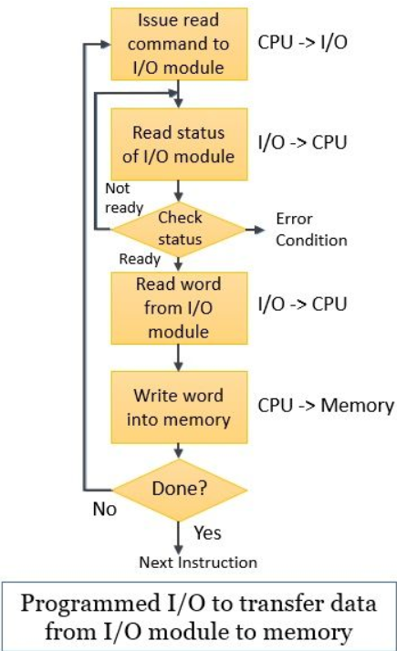
Cont…

Slide 35
I/O Addressing and Mapping.
As we have discussed above how the external device or peripheral recognizes that the processor is addressing them and has issued them the I/O command?
It is obvious that each device given unique identifier (Address).
Therefore, CPU commands contain identifier(Address).
So, when the processor, main memory, and I/O module share the common bus then addressing can be achieved in two ways.
Memory-mapped I/O and Isolated I/O.

Slide 36
Memory-mapped I/O
Memory-mapped I/O uses the same address space to address both memory and I/O devices.
Both memory and I/O devices use the same address space. We assign some of the memory addresses to I/O devices.
The memory and registers of the I/O devices are mapped to (associated with) address values.
So when an address is accessed by the CPU, it may refer to a portion of physical RAM, or it can instead refer to memory of the I/O device.
Thus, the CPU instructions used to access the memory can also be used for accessing devices.

Slide 37
Cont…
To accommodate the I/O devices, areas of the addresses used by the CPU must be reserved for I/O and must not be available for normal physical memory.
The CPU either communicates with computer memory or some I/O devices depending on the address.
Therefore, we reserve a part of the address space for I/O devices, which is not available for computer memory.
In the case of memory-mapped I/O, all the buses are the same for both memory and I/O devices.
Therefore, building a CPU that uses memory-mapped I/O is easier, cheaper and consume less power due to reduced complexity.

Slide 38
Cont…
One advantage of memory-mapped I/O is that we don’t need separate instruction sets for accessing I/O devices and memory.
Instructions used for accessing memory can be easily used for accessing I/O devices.
Therefore, every bus in common due to which the same set of instructions work for memory and I/O.
Hence we manipulate I/O same as memory and both have same address space, due to which addressing capability of memory become less because some part is occupied by the I/O.
With the memory-mapped I/O, the processor access memory and I/O using a single address space.
Here the processor uses the same address, data, and control bus. So, the same set of machine instructions addresses both memory and I/O.

Slide 39
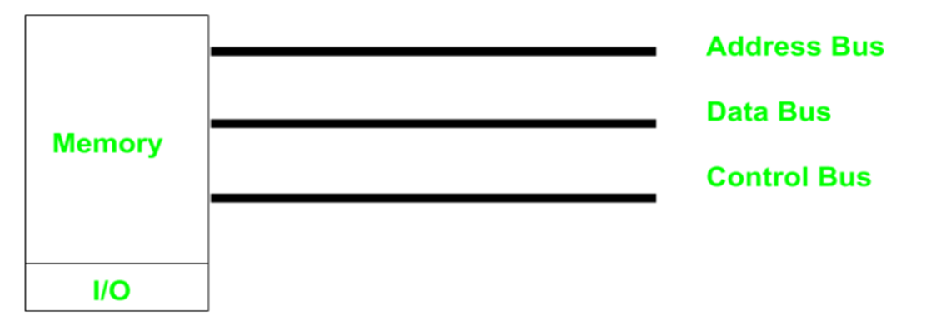
Cont…

Slide 40
Port-mapped I/O (PMIO)
I/O devices have a separate address space from general memory, either accomplished by an extra "I/O" pin on the CPU's physical interface, or an entire bus dedicated to I/O.
Because the address space for I/O is isolated from that for main memory, this is sometimes referred to as isolated I/O. As the address space of memory and I/O is isolated and the name is so.
Port-mapped I/O often uses a special class of CPU instructions designed specifically for performing I/O.
Here there are common bus(data and address) for I/O and memory but separate read and write control lines for I/O. So, the isolated I/O technique has its own dedicated instruction set for accessing I/O devices.
Here we have different read-write instruction for both I/O and memory.

Slide 41
Cont…
So when CPU decode instruction then if data is for I/O then it places the address on the address line and set I/O read or write control line on.
This I/O method is also called isolated I/O because the memory space is isolated from the I/O space, thus the entire memory address space is available for application use.
I/O mapped I/O have a separate address space from the memory. So, total addressed capacity is the number of I/Os connected and a memory connected.
But ,drawback of isolated I/O is costlier compared to memory-mapped I/O and the CPUs that use isolated I/O are bigger and more complex to build. The addresses of I/O devices are also referred to as ports number.

Slide 42
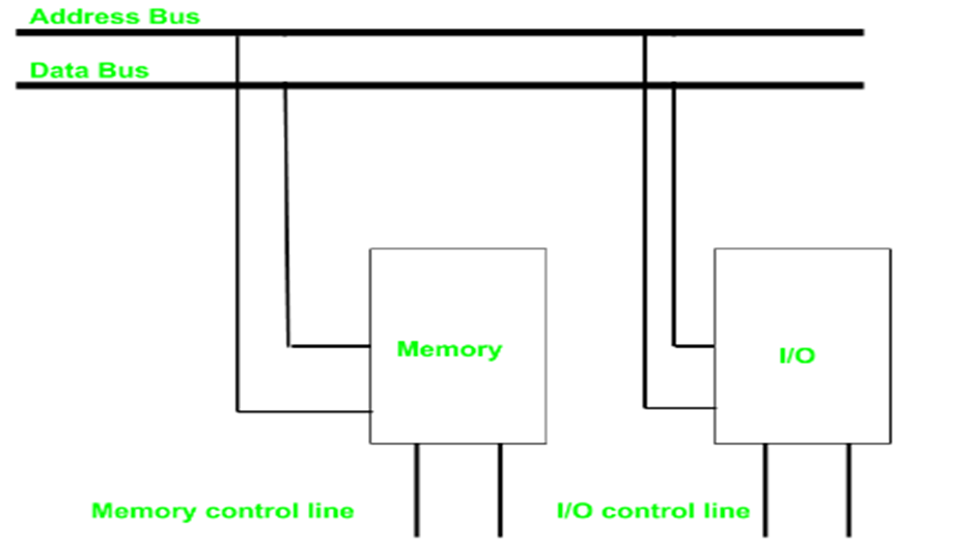
Cont…

Slide 43
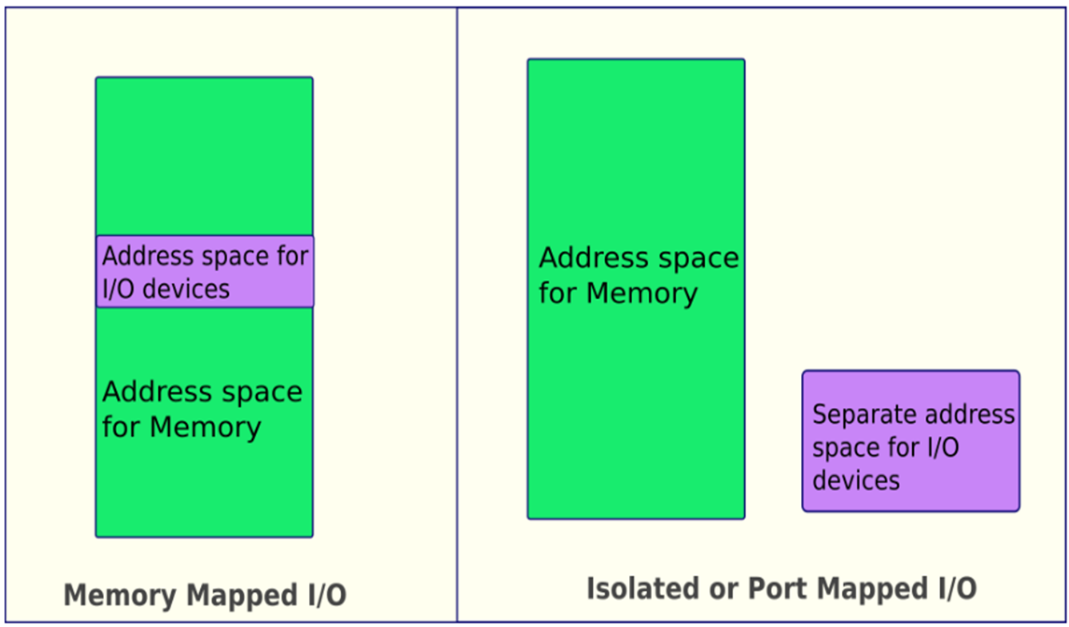
Memory mapped vs isolated I/O

Slide 44
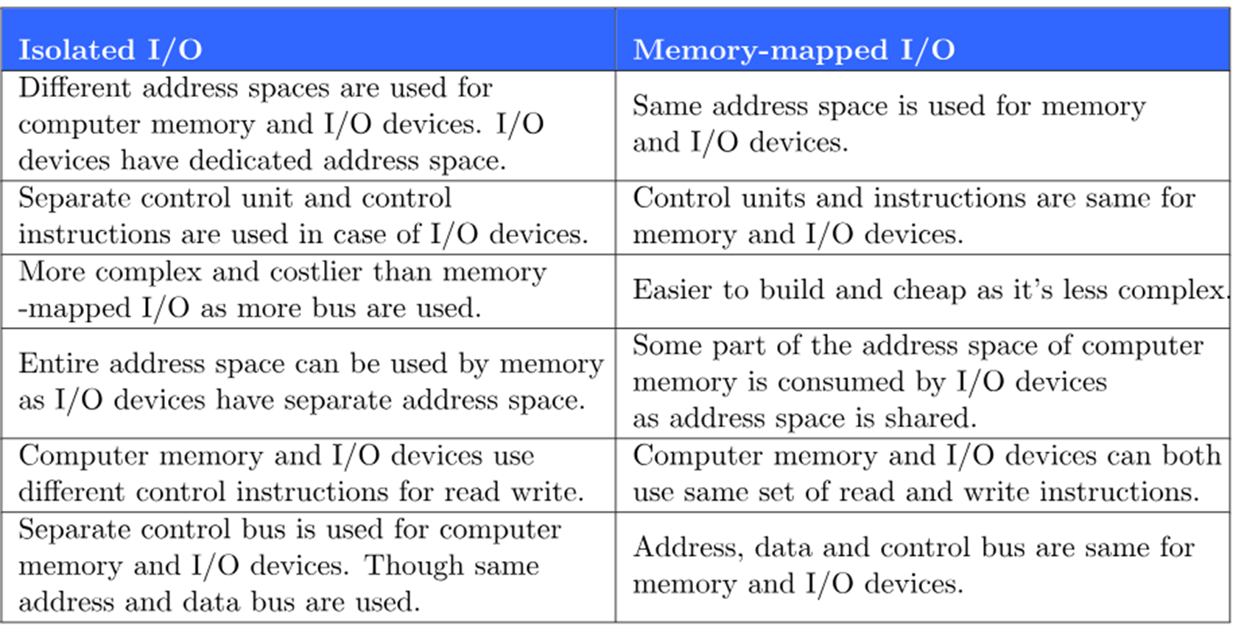
Cont…

Slide 45
Synchronous and Asynchronous I/O of data transfer
Synchronous I/O of data transfer.
When both the transmitting and receiving units use same clock pulse then such a data transfer is called Synchronous process.
For synchronous I/O operations, the process calling the I/O request is blocked until the I/O operation is complete and regains control of execution only when the request is completely satisfied.
In this organization, CPU execution waits while I/O proceeds which is so called blocking I/O. I.e. it would block the progress of a program while the communication is in progress, leaving system resources idle.
When a program makes many I/O operations (such as a program mainly or largely dependent on user input), this means that the processor can spend almost all of its time idle waiting for I/O operations to complete.

Slide 46
Asynchronous I/O of data transfer
On the other hand, if sender operates at different moment than the receiver, such a data transfer is called Asynchronous data transfer.
For asynchronous I/O operations, the process calling the I/O request immediately regains control of execution once the I/O operation is queued to the device.
It is also non-sequential I/O is a form of input/output processing that permits other processing to continue before the transmission has finished.
I.e. I/O proceeds concurrently with CPU execution.
Note, any task that depends on the I/O having completed still needs to wait for the I/O operation to complete, and thus is still blocked, but other processing that does not have a dependency on the I/O operation can continue.

Slide 47
Cont…
This Scheme is used when speed of I/O devices do not match with microprocessor and (I/O) operations on a computer can be extremely slow compared to the processing or execution of data.
So, it is possible to start the communication and then perform processing that does not require the I/O be completed.
In this method, process initiates the device and check its status. As a result, CPU has to wait till I/O device is ready to transfer data.
In this method there are two types of techniques or protocols are used based on signals before data transfer.
Strobe Control it employs a single control line to time each transfer. The strobe may be activated by either the source or the destination unit.
Handshaking Solves the problem of strobe method by introducing a second control signal that provides a reply to the unit that initiates the transfer.

Slide 48
Cont…
The transfer of data between two units is either serial or parallel.
In parallel data transmission, n bit in the message must be transmitted through n separate conductor path.
In serial transmission, each bit in the message is sent in sequence one at a time.
The start and the stop bit is introduced in the message during transmission with Asynchronous.
That ensure the data is transmitted correctly from the sender to the receiver.
Each bit of message is sent at a time, and binary information is transferred only when it is available. When there is no information to be transferred, line remains idle

Slide 49
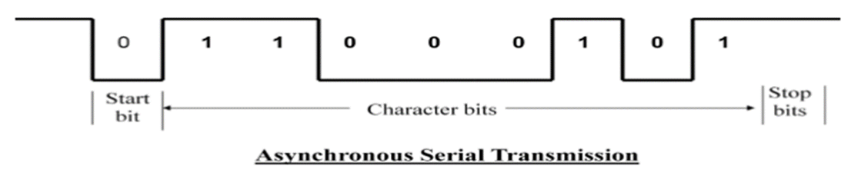
Cont…
Example: with serial technique each character consists of three points
Start bit - First bit, called start bit is always zero and used to indicate the beginning character.
Character bit .Bits in between the start bit and the stop bit are known as character bits. The character bits always follow the start bit.
Stop bit – Last bit, called stop bit is always one and used to indicate end of characters. Stop bit is always in the 1- state and frame the end of the characters to signify the idle or wait state.

Slide 50
Interrupt- initiated I/O
Interrupts are signals sent by hardware devices to the CPU to request immediate attention or to notify the CPU about a specific event or condition.
Since in program I/O, we saw the CPU is kept busy unnecessarily and this situation can avoided by using an interrupt driven method for data transfer.
I.e. it Overcomes CPU waiting. No repeated CPU checking of device and I/O module interrupts when ready.
By using interrupt facility and special commands to inform the interface to issue an interrupt request signal whenever data is available from any device.
In the meantime the CPU can proceed for any other program execution. The interface meanwhile keeps monitoring the device.

Slide 51
Cont…
Whenever it is determined that the device is ready for data transfer it initiates an interrupt request signal to the computer.
Upon detection of an external interrupt signal the CPU stops momentarily the task that it was already performing and branches to the service program to process the I/O transfer.
Then after completing the transfer CPU then return to the task it was originally performing.

Slide 52
Interrupt Processing handling mechanism.
The device issues an interrupt signal to the processor and when an interrupt occurs, the processor first finishes the current instruction.
CPU then suspends the current program by saving the address of next instruction on the stack and transfer control to ISR and executes an ISR in Interrupt Descriptor Table (IDT): based on the interrupt number.
(IDT): The operating system maintains an Interrupt Descriptor Table, which is an array of interrupt service routines (ISRs).
Each entry in the IDT corresponds to a specific interrupt number and points to the memory address of the ISR that should handle that interrupt.
That means, CPU pushes the value of PC (address of next instruction) into the stack and loads the ISR address into PC and proceeds to execute the ISR.
When interrupt processing is complete, the saved register values are retrieved from the stack and restored to the pc.
Restore the next instruction address to be executed.

Slide 53
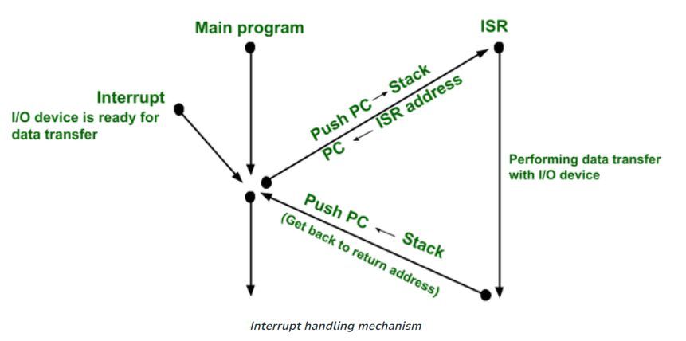
Cont…

Slide 54
Device Identification
How does the processor determine which device issued the interrupt?
There are four general categories of techniques
Multiple interrupt lines.
Software poll.
Daisy chain (hardware poll, vectored).
Bus arbitration (vectored).

Slide 55
Cont…
Multiple interrupt lines
In systems with multiple interrupt lines, each device has its dedicated interrupt line connected directly to the CPU or through an interrupt controller.
When an interrupt occurs, the device asserts its interrupt line, signaling the CPU to handle the interrupt. This approach allows for efficient and direct handling of interrupts from multiple devices simultaneously.
The CPU can quickly identify the interrupt source and execute the corresponding interrupt handler routine.
Advantages:
Parallel handling: Multiple interrupts from different devices can be handled in parallel, as each device has its dedicated interrupt line.
Efficient: The CPU can quickly identify the interrupt source, reducing latency and overhead associated with interrupt handling.

Slide 56
Cont…
Disadvantages:
Limited number of interrupt lines: The number of interrupt lines determines the maximum number of devices that can generate interrupts directly to the CPU.
If the number of devices exceeds the available interrupt lines, alternative methods like other three techniques must be used on each line.
Software Poll
Processor branches to an interrupt-service routine whose job is to poll each I/O module to determine which module caused interrupt.
In Polling and Interrupts of the microprocessor’s software simply checks each of the I/O devices every so often.

Slide 57
Cont…
During this check, the microprocessor tests to see if any device needs servicing. The CPU can implement complex algorithms or decision-making logic to determine the order in which devices are checked, prioritize certain devices over others, or perform additional processing before handling interrupts.
This is a simple program which services I/O ports A, B, and C. The polling routine checks the status of I/O ports in proper sequence.
It first transfers the status of I/O port A into the accumulator. Then the polling routine block checks the contents of accumulator to see if the service request bit is set. If it is, I/O port A service routine is called.

Slide 58
Cont…
After completion of service routine for I/O port A, the polling routine moves on to test port B and the process is repeated.
This test and service procedure continues until all the I/O port status registers are tested and all the I/O ports requesting service are serviced.
Once this is done, the microprocessor continues to execute the normal programs. The disadvantage of the software poll is that it is time consuming

Slide 59
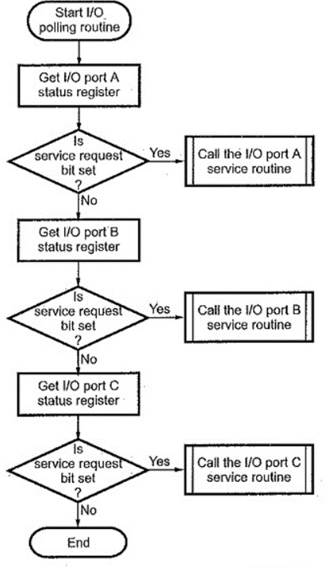
Cont…

Slide 60
Cont…
Daisy chain or hardware poll (vector).
The daisy-chaining method of establishing priority consists of a serial connection of all devices that request an interrupt.
The device with the highest priority is placed in the first position, followed by lower-priority devices up to the device with the lowest priority, which is placed last in the chain.
Interrupt Acknowledge sent down a chain by witch module responsible places vector on bus. CPU uses vector to identify handler routine.

Slide 61
Cont…
Bus arbitration:(vector)
In a computer system, multiple devices, such as the CPU, memory, and I/O controllers, are connected to a common communication pathway, known as a bus.
In order to transfer data between these devices, they need to have access to the bus.
Bus arbitration is the process of resolving conflicts that arise when multiple devices attempt to access the bus at the same time.
When multiple devices try to use the bus simultaneously, it can lead to data corruption and system instability.
To prevent this, a bus arbitration mechanism is used to ensure that only one device has access to the bus at any given time.

Slide 62
Cont…
Therefore, with bus arbitration, an I/O module must first gain control of the bus before it can raise the interrupt request line.
Only one module can raise the bus control line at a time. When the processor detects the interrupt, it responds on the interrupt acknowledge line.
The requesting module then places its vector on the data lines.
The controller that has access to a bus at an instance is known as a Bus master.
So, the current bus master accesses and then leaves the control of the bus and passes it to another bus requesting processor unit.

Slide 63
Multiple Interrupts
The above techniques serve to identify the requesting I/O module. But, if multiple interrupts have occurred at the same time , how does the processor decide which one to process first?
They also provide a way of assigning priorities when more than one device is requesting interrupt service.
Multiple lines: The processor just picks the interrupt line with the highest priority.
Software polling: The order in which modules are polled determines their priority.
Daisy Chain: The order of modules on a daisy chain determines their priority.
Bus arbitration: It can employ a priority order.

Slide 64
Types of Interrupts
Hardware Interrupts: Interrupts present in the hardware pins.
Software Interrupts: These are the instructions used in the program whenever the required functionality is needed.
Vectored interrupts: These interrupts are associated with the static vector address.
Non-vectored interrupts: These interrupts are associated with the dynamic vector address.
Maskable Interrupts: These interrupts can be enabled or disabled explicitly.
Non-maskable interrupts: These are always in the enabled state. we cannot disable them.
External interrupts: Generated by external devices such as I/O.
Internal interrupts: These devices are generated by the internal components of the processor such as power failure, error instruction, temperature sensor, etc.

Slide 65
Direct Memory Access (DMA)
Drawback: Interrupt driven and programmed I/O require active CPU intervention.
The I/O transfer rate is limited by the speed with which the processor can test and service a device.
The data transfer between a fast storage media such as magnetic disk and memory unit is limited by the speed of the CPU.
Thus we can allow the peripherals directly communicate with a memory unit using the memory buses, by removing the intervention of the CPU.
When large volumes of data are to be moved, a more efficient technique is required: direct memory access (DMA).

Slide 66
Cont…
The DMA module is capable of taking over control of the system from the processor to transfer data to and from memory over the system bus.
The DMA module must use the bus only when the processor does not need it, or it must force the processor to suspend operation temporarily.
During DMA the CPU is idle and it has no control over the memory buses.
The DMA controller takes over the buses to manage the transfer directly between the I/O devices and the memory unit.

Slide 67
Cont…
The total time taken to transfer the N bytes in DMA is:
Bus grant request time + (N) * (memory transfer rate) + Bus release control time.
Release the control of the bus back to CPU So, total time taken to transfer the N bytes = Bus grant request time + (N) * (memory transfer rate) + Bus release control time.
This is first, Buffer the byte into the buffer.
Inform the CPU that the device has 1 byte to transfer (i.e. bus grant request)
Transfer the byte (at system bus speed)
Release the control of the bus back to CPU.
Processor is involved only at the beginning and end of the transfer.

Slide 68
DMA Operation
CPU tells DMA controller the following:
Read/Write.
Device address.
Starting address of memory block for data.
Amount of data to be transferred.
The processor carries on with other work.
DMA controller deals with transfer directly to or from memory, without going through the processor.
DMA controller sends interrupt when finished.
Processor is involved only at the beginning and end of the transfer.

Slide 69
The end

